Slide 1
Music Synthesis/ Analysis
Michelle Qiu
Germain Martinez
Gerzain Mata

Slide 2
Premise
The user sings/ hums/ plays an instrument
A microphone picks up the sound
The sound is saved onto memory for later playback
Audio effects can be added to the sound samples
Up to 2 samples can be recorded

Slide 3
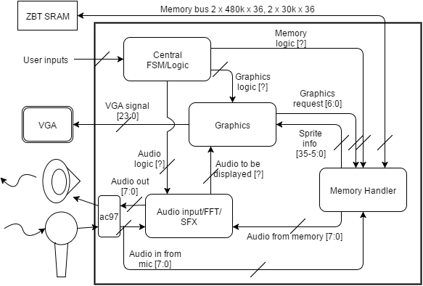
Block Diagram

Slide 4
Memory Handler
Take in input from microphone
Write audio samples to memory
Retrieve sound samples from memory
Retrieve image data from memory for Graphics Module
Bus Sharing – Image and Audio share memory bus
Use ZBT Memory – 512k x 36 bit memory bus

Slide 5
Audio Module
Take input from MICROPHONE and write to memory
Take EFFECTS from FSM and apply them to recorded audio
Output FFT data to Graphics module
Output sound to SPEAKER
Most complex part of project

Slide 6
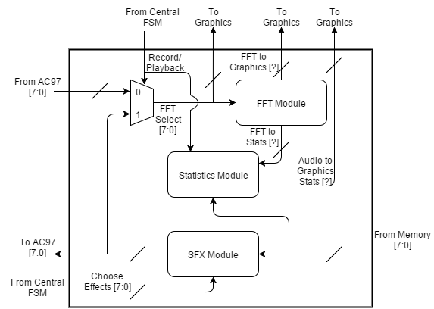
Audio Module - Block Diagram

Slide 7
Graphics Module
Take in graphics from the memory
Output FFT spectral data
Display running statistics (predominant frequency, amplitude, sample characteristics)
Take in data from ZBT memory
36 bit bus → 6 bit pixel encoding = 6 pixels per memory read
6 bit pixel encoding -> 24 bit color to VGA -> LUT
30+ different images for text/numbers/etc.

Slide 8
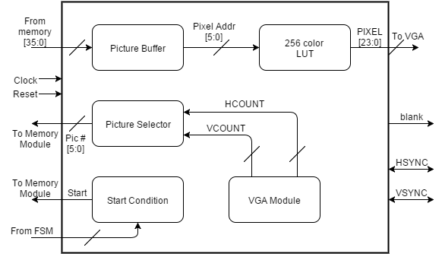
Graphics Module – Block Diagram

Slide 9
Central FSM
Controlling Logic happens here
In charge of coordinating between modules
Each team member should implement part of the FSM most pertinent to their individual module
Take INPUT from buttons/ switches and choose which bank to record to and what effects to apply

Slide 10
Specifics
12 kHz sampling rate and 8 bit encoding scheme
192 kilobits per second data rate
~243 kSlots of ZBT memory required for 10-second recording
Use one bank of memory for each sound recording
Necessary to leave space for image data

